Slide 1
Core Java Concept

Slide 2
Compiling Topics
Recursion
Static & this Keyword
Strings & Array In Java
StringBuffer & StringBuilder
Inner Classes
Enum
Access Modifiers in java
Overloading & Overriding
Basic of java Threads

Slide 3
Recursion in Java
Process of solving a problem by reducing it to smaller versions of itself.
Recursive algorithm
  Algorithm that finds the solution to a given problem by reducing the problem to smaller versions of itself
  Has one or more base cases
  Implemented using recursive methods
Recursive method
  Method that calls itself
Base case
  Case in recursive definition in which the solution is obtained directly
  Stops the recursion

Slide 4
Recursion in Java
General solution
  Breaks problem into smaller versions of itself
General case
  Case in recursive definition in which a smaller version of itself is called
  Must eventually be reduced to a base case

Slide 5
Static Keyword in Java
The static keyword is used when a member variable of a class has to be shared between all the instances of the class.
All static variables and methods belong to the class and not to any instance of the class.
When can we access static variable
  When a class is loaded by the virtual machine all the static variables and methods are available for use.
  Hence we don’t need to create any instance of the class for using the static variables or methods.
  Variables which don’t have static keyword in the definition are implicitly non static.

Slide 6
Static Method in Java
If you apply static keyword with any method, it is known as static method.
  A static method belongs to the class rather than object of a class.
  A static method can be invoked without the need for creating an instance of a class.
  static method can access static data member and can change the value of it.
  Everything that is marked static belongs to the class only, for example static method cannot be inherited in the sub class because they belong to the class in which they have been declared
Java doesn’t support static constructor
  Since each constructor is being called by its subclass during creation of the object of its subclass, so if you mark constructor as static the subclass will not be able to access the constructor of its parent class because it is marked static and thus belong to the class only.

Slide 7
Example
Class StaticDemo{
public static int a = 100; // All instances of StaticDemo have this variable as a common variable
public int b =2 ;
public static showA(){
System.out.println(“A is “+a);
}
}
Class ExecClass{
public static void main(String args[]){
StaticDemo.a = 35; // when we use the class name, the class is loaded, direct access to a without any instance
StaticDemo.b=22; // ERROR this is not valid for non static variable
StaticDemo demo = new StaticDemo();
demo.b = 200; // valid to set a value for a non static variable after creating an instance.
StaticDemo.showA(); //prints 35
}}

Slide 8
What is this Keyword in Java .
this is a keyword in Java.
this can be used inside method or constructor of class.
this works as a reference to current object whose method or constructor is being invoked.
this keyword can be used to refer any member of current object from within an instance method or a constructor.

Slide 9
Usage of this Keyword in java
Here is given the 6 usage of Java this keyword.
  this keyword can be used to refer current class instance variable.
  this() can be used to invoke current class constructor.
  this keyword can be used to invoke current class method (implicitly)
  this can be passed as an argument in the method call.
  this can be passed as argument in the constructor call.
  this keyword can also be used to return the current class instance.
    class A{
    int w;
    public void setValue (int w) {
      this.w = w; //same name!
    }
    }

Slide 10
String in Java
The String class is defined in the java.lang.package
String object is immutable.
String is the only class which has "implicit" instantiation.
Creating String object with the new keyword
String name;
name=new String(“xyz”);
Creating String object using String literal
String name;
name=”xyz”;

Slide 11
Strings can also be created using the + operator.
String name; Int age=12;
String name=”FirstName”+”age is”+age;
String objects created using string literal are stored in the String Constant Pool and any two objects in the pool can’t have same content
Difference between String literal and New String
  Both expression gives you String object, but there is subtle difference between them.
  When you create String object using new() operator, it always create a new object in heap memory.
  On the other hand, if you create object using String literal syntax e.g. "Java", it may return an existing object from String pool (a cache of String object in Perm gen space, which is now moved to heap space in recent Java release), if it's already exists. Otherwise it will create a new string object and put in string pool for future re-use.

Slide 12
The String class has many methods. The most commonly used are:
  length() - returns the number of characters in the String
  charAt() - returns the character at the specified index
  equals() - returns true if two strings have equal contents
  compareTo() -returns 0 if equal, -# if one String is "less than” the other, +# if one String is "greater than" the other.
  indexOf() - returns the index of specified String or character
  substring() -returns a portion of the String's text
  toUpperCase(), toLowerCase() - converts the String to upper or lower case characters

Slide 13
Array in Java
Java Supports Array
An array is a collection of elements where each element is the same type.
  Element type can be primitive or Object
  Each element is a single value
  The length of the array is set when it is created. It cannot change.
Individual array elements are accessed via an index.
  Array index numbering starts at 0.
Creating an array is a 2 step process
  It must be declared (declaration does not specify size)
    type[ ] arrayName;

Slide 14
  int [ ] grades;
It must be created (ie. memory must be allocated for the array)
  grades=new int[5];
Another way of initializing lists is by using initializer lists.
  The array is automatically created
  The array size is computed from the number of items in the list.
type[] arrayName = {initializer_list};
int[] grades = {100, 96, 78, 86, 93};
String[] colours = {"Red", "Orange"}, "Green",
"Blue", "Indigo",
"Violet"};

Slide 15
Multi-Dimensional Arrays in Java
The arrays you have been using so far have only held one column of data.
But you can set up an array to hold more than one column. These are called multi-dimensional arrays.
When we create an array in Java, the number of pairs of square brackets indicates the dimensions of the array. So far, we’ve only used one-dimensional arrays.
    Int[ ] arr = new int[10];
2D array of integers:
Int[ ][ ] matrix = new int[4][3];
// 4 rows, 3 columns

Slide 16
Int[ ][ ] matrix = new int[4][3];
Making sense of it all:
  matrix is a reference to the entire array
  matrix[i][j] is for the entry in row i, column j indexing for both rows and columns starts at 0.
  matrix[0][0] is the int in the first row and first column
  matrix[i] refers to row i matrix[0] refers to the first row, or the row with index 0

Slide 17
String Builder and String Buffer in Java
A String Builder has a capacity (the number of characters it can hold) and a length (the number of characters it is currently holding)
If the capacity is exceeded, the String Builder is copied to a new location with more room
String Builder is a reimplementation of String Buffer
  The API (collection of methods) is the same
  String Buffers are thread safe, but String Builders are more efficient
String Builders are used to implement String concatenation
Whenever you say String s = "ab" + "cd", Java creates a String Builders containing the characters a and b, appends the characters c and d to it, and converts the result back to a String

Slide 18
A String Buffer is synchronized i.e. thread safe. It means two threads can't call the methods of String Buffer simultaneously.
String Buffer is less efficient than String Builder
String Builder is non-synchronized i.e. not thread safe. It means two threads can call the methods of String Builder simultaneously.
String Builder is more efficient than String Buffer
String is an immutable class while String Builder & String Buffer are mutable classes
public class BuilderTest{
public static void main(String[] args){
StringBuilder builder=new StringBuilder("hello");
builder.append("java");
System.out.println(builder);
}
}

Slide 19
String v/s String Buffer v/s String Builder
 | String | StringBuffer | StringBuilder
Storage Area | Constant String Pool | Heap | Heap
Modifable | No(immutable) | Yes(mutable) | yes(mutable)
Thread Safe | Yes | Yes | No
Performances | Fast | Very Slow | Fast

Slide 20
Inner Class in Java
Inner classes are classes defined within other classes
The class that includes the inner class is called the outer class
There is no particular location where the definition of the inner class (or classes) must be place within the outer class
Placing it first or last, however, will guarantee that it is easy to find
Simple Uses of Inner Classes
  An inner class definition is a member of the outer class in the same way that the instance variables and methods of the outer class are members
  The name of an inner class may be reused for something else outside the outer class definition
  If the inner class is private, then the inner class cannot be accessed by name outside the definition of the outer class

Slide 21
Inner Class in Java
If you want to create an inner class code outside of the outer class code
OuterClass.InnerClass inner = new
OuterClass().new InnerClass();
OR
OuterClass outClass = new OuterClass();
OuterClass.InnerClass inner = outClass.new InnerClass();

Slide 22
Four kinds of inner classes
Member classes
  An ordinary class, just defined within another
  Has full access to the variables of the enclosing class
Anonymous classes
  Useful for short Listeners used in only one place
  Has full access to the variables of the enclosing class
Static member classes (not too useful)
  Defined inside another class, but acts like an outer class
Local classes (not too useful)
  Defined within a method
  Can access final variables in the enclosing class

Slide 23
Enum
Enumerated values
Sometimes you want a variable that can take on only a certain listed (enumerated) set of valuesExples:
dayOfWeek: SUNDAY, MONDAY, TUESDAY, …
month: JAN, FEB, MAR, APR, …
gender: MALE, FEMALE
title: MR, MRS, MS, DR
The values are written in all caps because they are constants

Slide 24
Enum
An enum is actually a new type of class
You can declare them as inner classes or outer classes
You can declare variables of an enum type and get type safety and compile time checking
  Each declared value is an instance of the enum class
  Enums are implicitly public, static, and final
You can compare enums with either equals or ==
enums extend java.lang.Enum and implement java.lang.Comparable
  Hence, enums can be sorted
Enums override toString() and provide valueOf()

Slide 25
Example
Example:
Season season = Season.WINTER;
System.out.println(season ); // prints WINTER
season = Season.valueOf("SPRING"); // sets season to Season.SPRING

Slide 26
Example
Example:
public void Daystatus(DayOfWeek day) {
switch (day) {
case MONDAY:
System.out.println("Mondays are bad.");
break;
case FRIDAY:
System.out.println("Fridays are better.");
break;
default:
System.out.println("Midweek days are so-so.");
break;
}}

Slide 27
Access modifiers
Determines access rights for the class and its members
Defines where the class and its members can be used
The access modifiers in java specifies accessibility (scope) of a data member, method, constructor or class.
There are 4 types of java access modifiers:
private
public
protected
default

Slide 28
1) private access modifier
The private access modifier is accessible only within class.
In this example, we have created two classes A and Simple. A class contains private data member and private method. We are accessing these private members from outside the class, so there is compile time error.
class A{
private int data=40;
private void msg(){System.out.println("Hello java");}
}
public class Simple{
public static void main(String args[]){
A obj=new A();
System.out.println(obj.data);//Compile Time Error
obj.msg();//Compile Time Error
} }

Slide 29
If you make any class constructor private, you cannot create the instance of that class from outside the class. For example:
class A{
private A(){}//private constructor
void msg(){System.out.println("Hello java");}
}
public class Simple{
public static void main(String args[]){
A obj=new A();//Compile Time Error
}
}

Slide 30
2) public access modifier
The public access modifier is accessible everywhere. It has the widest scope among all other modifiers.
package pack;
public class A{
public void msg(){System.out.println("Hello");}
}
package mypack;
import pack.*;
class B{
public static void main(String args[]){
A obj = new A();
obj.msg();
} }
OUTPUT:Hello

Slide 31
3) protected access modifier
The protected access modifier is accessible within package and outside the package but through inheritance only.
The protected access modifier can be applied on the data member, method and constructor. It can't be applied on the class.
In this example, we have created the two packages pack and mypack. The A class of pack package is public, so can be accessed from outside the package. But msg method of this package is declared as protected, so it can be accessed from outside the class only through inheritance.
package pack;
public class A{
protected void msg(){System.out.println("Hello");}
}

Slide 32
//save by B.java
package mypack;
import pack.*;
class B extends A{
public static void main(String args[]){
B obj = new B();
obj.msg();
}
}
Output Hello

Slide 33
4) default access modifier
If you don't use any modifier, it is treated as default by default. The default modifier is accessible only within package.
In this example, we have created two packages pack and mypack. We are accessing the A class from outside its package, since A class is not public, so it cannot be accessed from outside the package.
//save by A.java
package pack;
class A{
void msg(){System.out.println("Hello");}
}

Slide 34

//save by B.java
package mypack;
import pack.*;
class B{
public static void main(String args[]){
A obj = new A();//Compile Time Error
obj.msg();//Compile Time Error
} }

Slide 35
Overloading and Overriding
OVERLOADING
If a class have multiple methods by same name but different parameters, it is known as Method Overloading.
If we have to perform only one operation, having same name of the methods increases the readability of the program.
Different ways to overload the method
  There are two ways to overload the method in java.
    By changing number of arguments
    By changing the data type

Slide 36
Example
Example of Method Overloading by changing the no. of arguments
  class Calculation{
  void sum(int a,int b){System.out.println(a+b);}
  void sum(int a,int b,int c){System.out.println(a+b+c);}
  public static void main(String args[ ]){
  Calculation obj=new Calculation();
  obj.sum(10,10,10);
  obj.sum(20,20);
  } }

Slide 37
Example of Method Overloading by changing data type of argument
  class Calculation2{
    void sum(int a,int b){System.out.println(a+b);
  }
  void sum(double a,double b){
    System.out.println(a+b);
    }
  public static void main(String args[]){
  Calculation2 obj=new Calculation2();
  obj.sum(10.5,10.5);
  obj.sum(20,20);
  }
  }
  Output:21.0
  40

Slide 38
Overriding
If subclass (child class) has the same method as declared in the parent class, it is known as method overriding in java .
Rules for Java Method Overriding
  Method must have same name as in the parent class
  Method must have same parameter as in the parent class.
  Must be IS-A relationship (inheritance).

Slide 39
Example
Example of Method Overriding
  class Vehicle{
    void run(){System.out.println("Vehicle is running");}
  }
  class Bike2 extends Vehicle{
  void run(){System.out.println("Bike is running safely");
    }
  public static void main(String args[]){
  Bike2 obj = new Bike2();
  obj.run();
  }

Slide 40
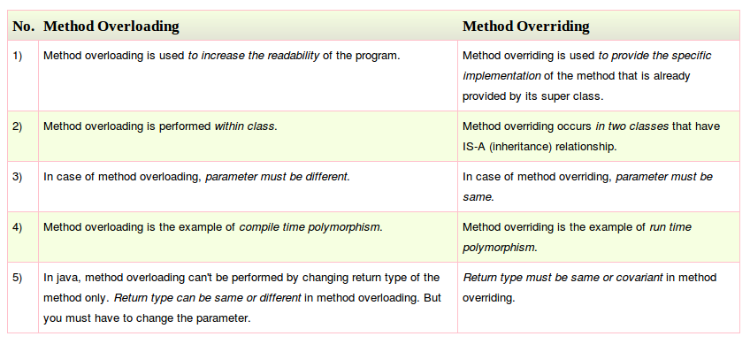
Difference between Overloading & Overriding

Slide 41
Threads in Java
What is a Thread?
Thread is Individual and separate unit of execution that is part of a process
  multiple threads can work together to accomplish a common goal
Video Game example
  one thread for graphics
  one thread for user interaction
  one thread for networking

Slide 42
Life cycle of a Thread (Thread States)
A thread can be in one of the five states
  New: The thread is in new state if you create an instance of Thread class but before the invocation of start() method
  Runnable: The thread is in runnable state after invocation of start() method, but the thread scheduler has not selected it to be the running thread
  Running: The thread is in running state if the thread scheduler has selected it
  Non-Runnable (Blocked): This is the state when the thread is still alive, but is currently not eligible to run
  Terminated: A thread is in terminated or dead state when its run() method exits.

Slide 43
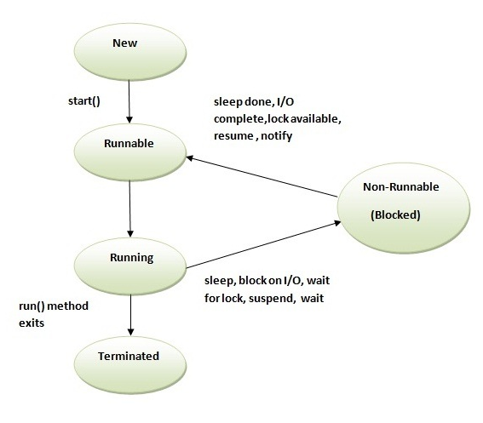

Slide 44
Advantages of Threads
Easier to program
  1 thread per task
provide better performance
  Thread only runs when needed
  no polling to decide what to do
Multiple threads can share resources
Utilize multiple processors if available

Slide 45
Disadvantages of Threads
Multiple threads can lead to deadlock
Overhead of switching between threads

Slide 46
Creating Threads(method1)
extending the Thread class
  must implement the run() method
  thread ends when run() method finishes
  call .start() to get the thread ready to run

Slide 47
Creating Threads(method1)
extending the Thread class
  must implement the run() method
  thread ends when run() method finishes
  call .start() to get the thread ready to run

Slide 48
class Output extends Thread {
private String toSay;
public Output(String st) {
toSay = st;
}
public void run() {
try {
for(;;) {
System.out.println(toSay);
sleep(1000);
}
} catch(InterruptedException e) {
System.out.println(e);
}
}
}

Slide 49
class Program {
public static void main(String [] args) {
Output thr1 = new Output(“Hello”);
Output thr2 = new Output(“There”);
thr1.start();
thr2.start();
}
}

Slide 50
Creating Threads(method 2)
implementing Runnable interface
  virtually identical to extending Thread class
  must still define the run()method
  setting up the threads is slightly different

Slide 51
class Output implements Runnable {
private String toSay;
public Output(String st) {
toSay = st;
}
public void run() {
try {
for(;;) {
System.out.println(toSay);
Thread.sleep(1000);
}
} catch(InterruptedException e) {
System.out.println(e);
}
}
}

Slide 52
class Program {
public static void main(String [] args) {
Output out1 = new Output(“Hello”);
Output out2 = new Output(“There”);
Thread thr1 = new Thread(out1);
Thread thr2 = new Thread(out2);
thr1.start();
thr2.start();
}
}
Advantage of Using Runnable
remember - can only extend one class
implementing runnable allows class to extend something else

Slide 53
Controlling Java Threads
.start(): begins a thread running
.wait() and notify(): for synchronization
.stop(): kills a specific thread
.suspend() and resume(): suspend & resume thread
.join(): wait for specific thread to finish
.setPriority(): 0 to 10 (MIN_PRIORITY to MAX_PRIORITY); 5 is default (NORM_PRIORITY)

Slide 54
Question's ?

Slide 55
Thank You :)

